Slide 1
AI Fundamentals, MMAI 5000 S3 – Machine learning – Supervised ML Hemant Sangwan

Slide 2
Agenda – Machine Learning
Define Machine learning
Compare and contrast different types of machine learning (supervised, unsupervised, semi-supervised, and reinforcement)
Discuss examples and applications of Supervised ML
Linear regression
Classifiers: Perceptron, logistic models, and Naïve Bayes
Generative vs discriminatory models

Slide 3
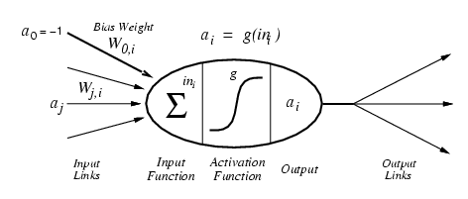
Machine Learning – Definition
"Machine learning is a field of computer science that gives computers the ability to learn [from data] without being explicitly programmed." Wikipedia

Slide 4
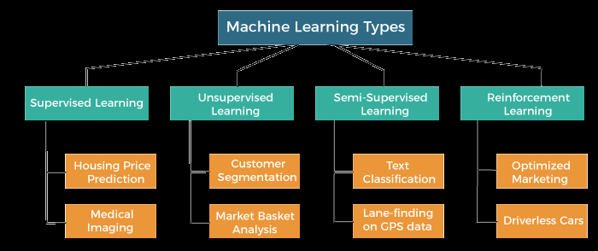
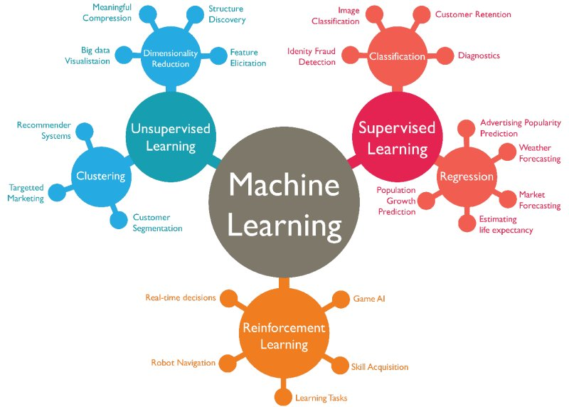
Machine Learning – Types and applications
Source: https://www.javatpoint.com/types-of-machine-learning
Source: https://www.kdnuggets.com/2019/04/poll-data-science-machine-learning-methods-algorithms-use-2018-2019.html

Slide 5
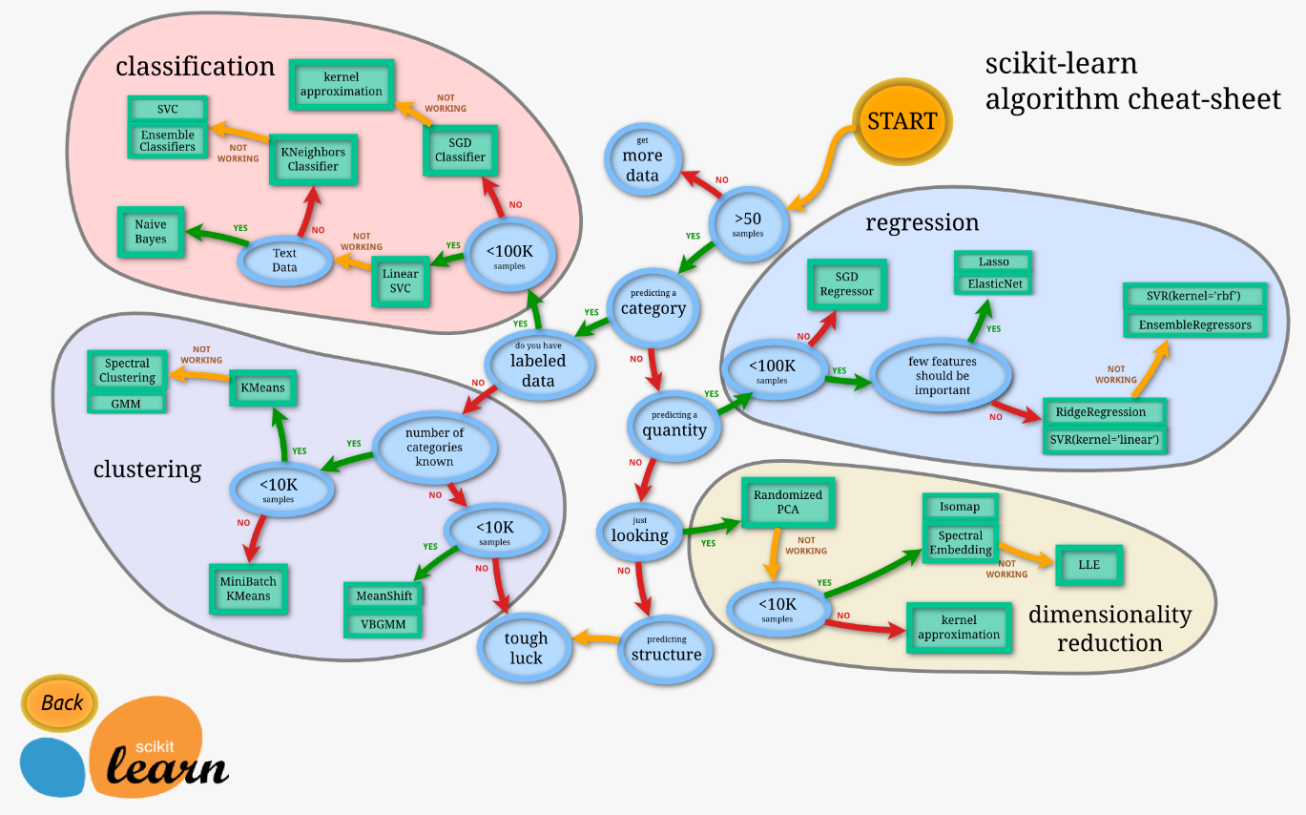
Machine Learning – Algorithms
Source: https://scikit-learn.org/stable/tutorial/machine_learning_map/index.html

Slide 6
Machine learning – Supervised
Machine learning – a program that learns from experience
Supervised: The computer is “taught” with examples of desired inputs and outputs, and goal is to learn from “input-output” relationships
Assume an unknown function f that returns output y given some input X, i.e., y = f(X)
Supervised learning: learn a function h that approximates f. y ≈ h(X)
X= price, y= sales OR X = price, y = purchase or no purchase (categorical variable)

Slide 7
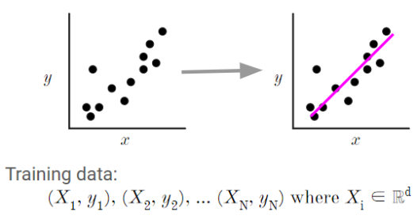
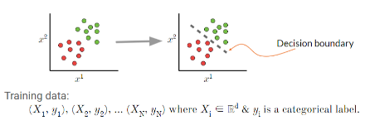
Machine learning – Supervised
An unknown function f that returns output y given some input X, i.e., y = f(X)
Supervised learning: learn a function h that approximates f. y ≈ h(X)
Correct output known for each training example, i.e., data are labeled, and the algorithm learns h that approximates f
X= price, y= sales; OR X = price, y = purchase / no purchase (categorical variable)
X= independent variable or feature, y = dependent variable or outcome
Question – What is the target variable in each of the figures given here?
and yi ∈ ℝ.

Slide 8
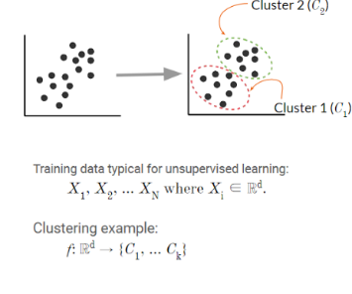
Machine learning – Unsupervised
Machine learning – a program that learns from experience
Unsupervised: The computer is “left on its own” to find structure in the data and learn the relationships between various inputs
It create an internal representation of the input, capturing regularities/structure/patterns in data, i.e., unlabeled data, i.e., no distinction between dependent and independent variables
Question – What is the target variable in the figure given here?

Slide 9
A few other types of learning
Classic: supervised, unsupervised, reinforcement
Hybrid:
Semi-supervised: a few labelled and many unlabeled data
Self-supervised: unsupervised learning with a supervised learner (e.g., language model)
Learning techniques
Multi-task learning: Supervised learning predicting multiple targets
Transfer learning: Train on one task and use the model on another task (often after fine-tuning)
Online learning: Update (train) the model as new data arrives

Slide 10
Machine learning – Supervised vs Unsupervised
Supervised
You are an investment analyst at a boutique firm in downtown Toronto. One of your clients loves investing in gold and thinks gold provides the best hedging against inflation than investing in stocks. The client provided you with the data on GP (gold price index), TSX index, and CPI (inflation index)
If your client’s brief is correct → gold prices rise faster than TSX relative to inflation. How to establish such relationship between (GP/CPI) or (TSX/CPI)
Predict GP (or TSX) as a function of CPI, i.e., if CPI rises by 1%, how much GP (or TSX) will rise?
UnSupervised
Your team has collected data on 150 financial ratios used to measure health of a firm. The client has asked if there is a way to reduce 150 ratios to 10 categories/indices to simplify the task and present it to the CEO?
10 indices should be able to capture almost all information which is available in 150 different types of ratios
Predict which specific category (10 categories) each ratio is going to be assigned to?

Slide 11
Activity – Supervised or Unsupervised ML?
You are a campaign manager for a political candidate and want to identify three groups of voters who have views similar (or not similar) to your candidate on key issues like health care, public transportation, climate change, and infrastructure investment
For town A, you want to predict how each voter in the town is going to be assigned to one of the three groups. The groups must be such that
Each group is similar or homogeneous with respect to certain characteristics
Each group must differ from other groups with respect to the same characteristics

Slide 12
Activity – Supervised or Unsupervised ML?
You are an investment analyst at a boutique firm in downtown Toronto. One of your clients loves investing in gold and thinks gold provides the best hedging against inflation than investing in stocks. The client provided you with the data on GP (gold price index), TSX index, and CPI (inflation index)
If your client’s brief is correct → gold prices rise faster than TSX relative to inflation. How to establish such relationship between (GP/CPI) or (TSX/CPI)
Your team has collected data on 150 financial ratios used to measure health of a firm. The client has asked if there is a way to reduce 150 ratios to 10 categories/indices to simplify the task and present it to the CEO?
10 indices should be able to capture almost all information which is available in 150 different types of ratios

Slide 13
Multiple Linear Regression (Supervised ML)

Slide 14
Agenda – Linear Regression
Linear Regression
Background and conceptual idea
Example and use cases
Interpretation of linear regression model
Estimation and Challenges
Regression, correlation, and causation
Activity – Linear regression in Excel

Slide 15
Linear Regression
Francis Galton (1880s) observed the following patterns in the data analysis
Tall parents likely have tall children
Short parents likely have short children
But height of children of unusually tall or unusually short parents tend to move to the average height of the population
Law of universal regression: observations tend to move around population mean, i.e., regression towards mean
Important theoretical result of central limit theorem (CLT) is based on regression towards mean

Slide 16
Key questions Linear Regression can help answer
How average height of sons change with father’s height?
Can we predict average height of sons knowing height of fathers
Note: the focus is on “average” height, not on specific height of an individual

Slide 17
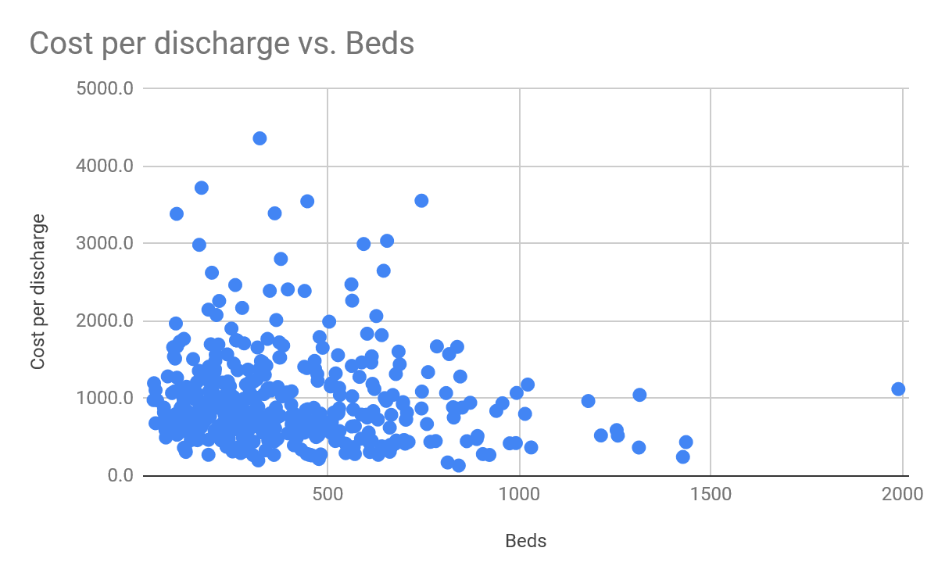
Linear Regression - Example
Corresponding to any value of beds (or size of the hospital) (e.g., 500, 1000), there is a range of cost per discharge
However, average cost per discharge decreases as # beds increases
Can we learn the relationship between (cost, size), i.e., y= h(x)
Can we predict average cost per discharge for a given value of # beds?

Slide 18
Regression – Interpretation of Coefficient and Error Terms
Error terms in y = h(x) = a + b x + e, where e= error term
Omitted variables: e accounts for OTHER variables which can affect y but not included in the model
Unavailability of data on some variables leads us to treat them all under e
Intrinsic randomness: There are things which cannot be explained, not matter how hard you try!
We want to build a relationship which is “parsimonious”, i.e., as simple as possible
‘e’ also accounts for “wrong” functional form of model
Coefficient ‘b’: Average change in y for a given change in x
Example: for every increase in size of the hospital by 1-unit, average change (decrease) in cost is -$100
Interpretation of coefficient of when x = categorical (x= small, medium, and large) or dummy variable
Example: when the hospital size changes from small to medium, the average change in cost is -$100

Slide 19
Linear Regression
Dependent variable (DV) – Alternative names
Explained variable
Predictand
Regressand
Response
Endogenous
Independent variable (IV) – Alternative names
Explanatory variable
Independent variable
Predictor
Control variable
Exogenous
Features

Slide 20
Multiple Linear Regression– Estimation

Slide 21
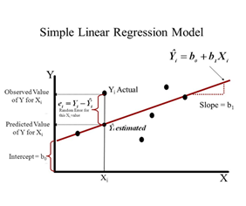
Linear Regression Estimation – Closed form solution
Closed form solution
y=a + b x + e, e= error term
Minimize squared distance (error) between observed and predicted Y, the DV
SSE: Sum of Square of Errors: Measure of variance in y which cannot be explained by x
$$SSE= \sum_{i=1}^{N}{{\left(y_{i}−(a+bx_{i}\right))}^{2}}$$
$$b=\frac{cov(y,x)}{var(x)}=\frac{\sum_{i=1}^{N}{(x_{i}−\overline{x})(y_{i}−\overline{y})}}{\sum_{i=1}^{N}{{(x_{i}−\overline{x})}^{2}}}$$
b$={\left(X^{′}X\right)}^{−1}X^{′}y$

Slide 22
Linear Regression Estimation – ML algorithm (Gradient Descent, GDD)
An ML algorithm for linear regression has the following two objectives
“Learn” the relationship between (x,y), i.e., make (a + b x) or h(ϑ) as close to y as possible
“Predict” y based on the “learned” relationship and new values of x’s
In other words, we make the algorithm “learn” the relationship between (x,y) so it can make predictions about y for new values of x’s

Slide 23
Linear Regression using ML algorithm – Key terminology
Model y=h(ϑ)=a₀+b₂x₁+b₂x₂+𝜖 is called “hypothesis”, i.e., we are hypothesizing how (x,y) are related, i.e., in this case linear relationship between (x,y)
ϑ’s are model parameters. And it is a (k x 1) vector, where k= number of parameters
x’s are features. x is a (k x n) matrix where n= number of observations, x₀=1
Training sample: the sample we use to “train” our ML algorithm
Test sample: the sample we use to “test” our “trained” algorithm!
n₀= training sample, n₁= test sample; n₀ + n₁ = n = total sample size

Slide 24
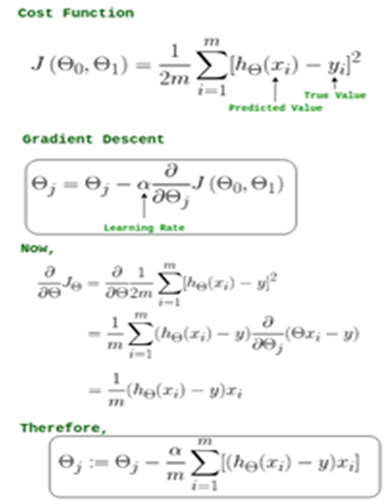
Linear Regression Estimation – Closed form vs ML algorithm
ML algorithm
Closed form solution
$$SSE= \sum_{i=1}^{N}{{\left(y_{i}−(a+bx_{i}\right))}^{2}}$$
$$b=\frac{cov(y,x)}{var(x)}=\frac{\sum_{i=1}^{N}{(x_{i}−\overline{x})(y_{i}−\overline{y})}}{\sum_{i=1}^{N}{{(x_{i}−\overline{x})}^{2}}}$$

Slide 25
Multiple Linear Regression – Challenges

Slide 26
Linear Regression Estimation Challenges
Multicollinearity
When X’s (features, IVs) are correlated, it is difficult to understand the unique impact of each variable on y.
Example: Effect of Age and Height on IQ. Age and Height are positively correlated
Unbiasedness of parameters
In repeated samples (s=1,2,3,4,5,6…..1000….), what would be the average (across samples) of parameters?
Is the average being equal to / close to the true parameter which was hypothesized?

Slide 27
Linear Regression – Assumptions
The most important assumption of a linear regression model is that the specified relationship between (y, X) is correct, i.e., y is the target variable, X= feature, and not the other way round
We assume the heights of children depends on the heights of parents, and not the other way round
We assume the cost per discharge depends on # beds (and not the other way round)
In addition, there are four important assumptions for a linear regression model
Linearity of relationship between (x,y)
Error terms have equal variance, i.e., Var [e(i)]=Var (e(j)) for all i,j
Errors terms are uncorrelated, i.e., CoVar [e(i), e(j)]= 0 for all i ≠ j
Error terms follow normal distribution e(i)~N[0, Var(e(i))]
What would happen when you relax these assumptions?
How would you make your linear regression model work when one or more of these assumptions do not hold true?

Slide 28
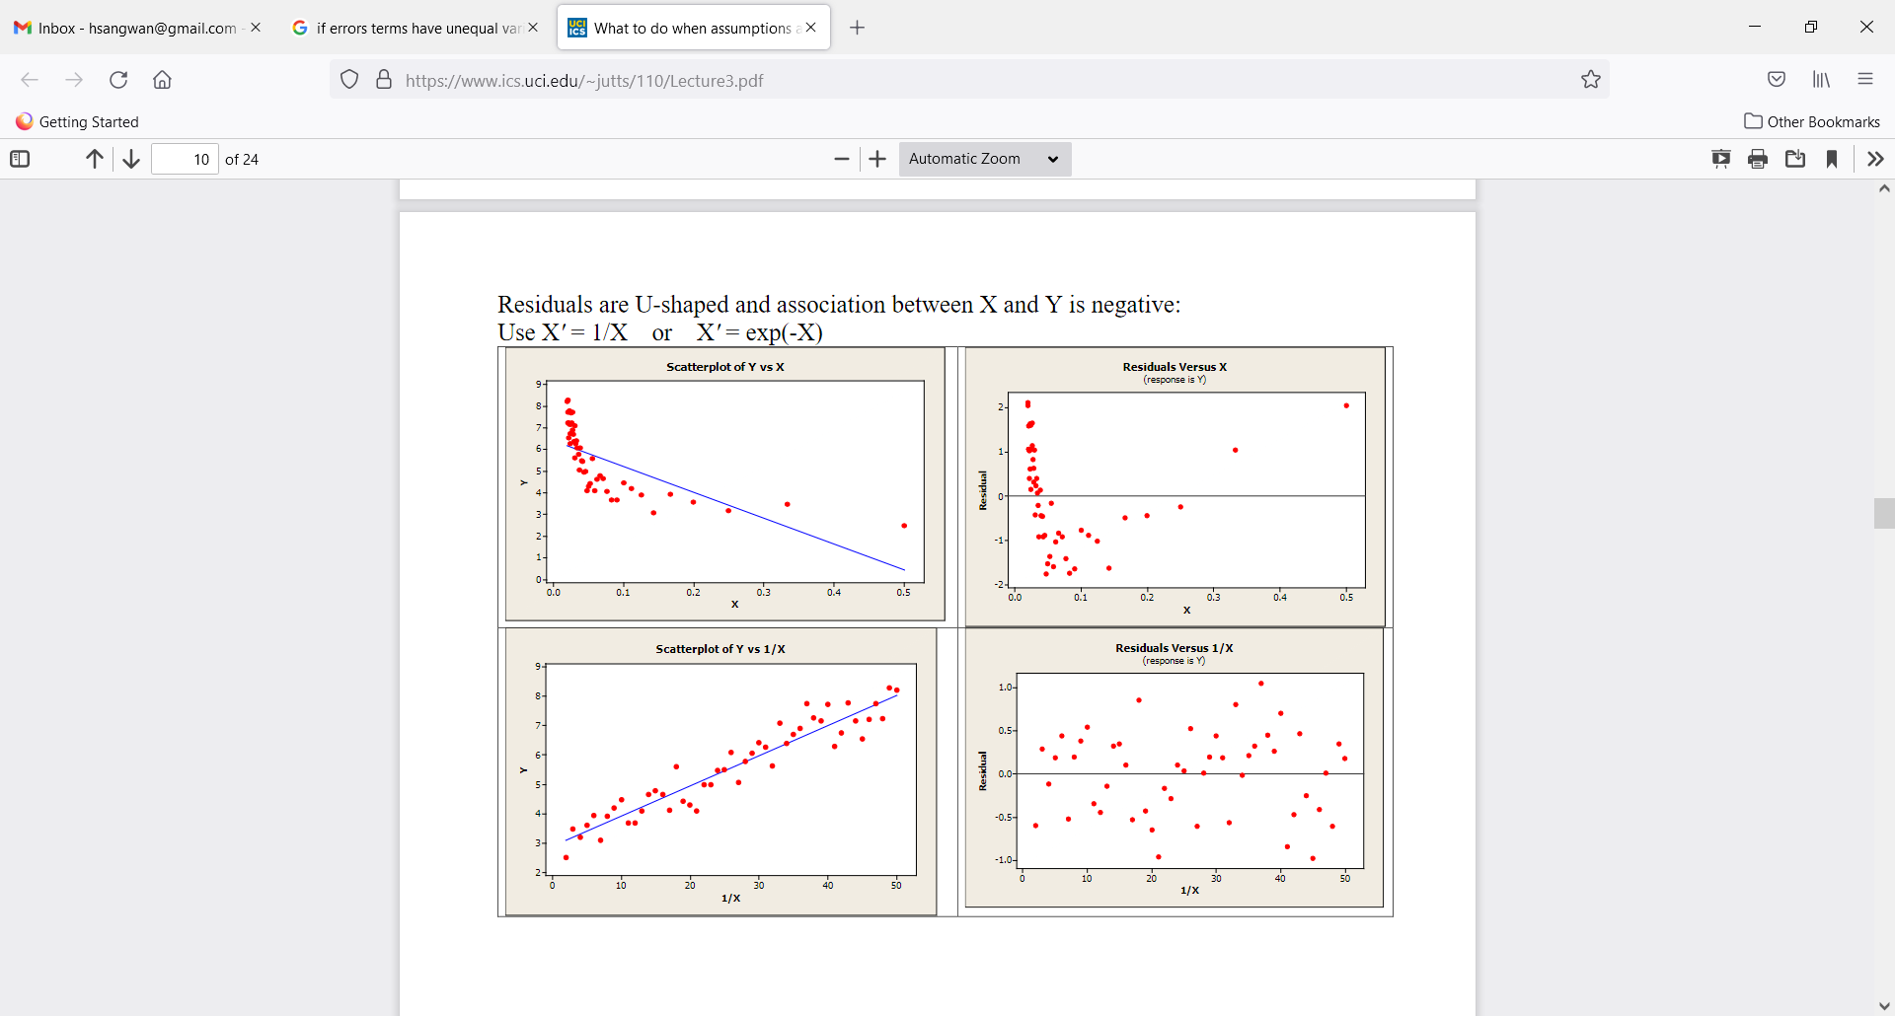
Assumption violated – Linearity of relationship between (x,y)
Transform X, i.e., X’=f(X) to make the relationship linear

Slide 29
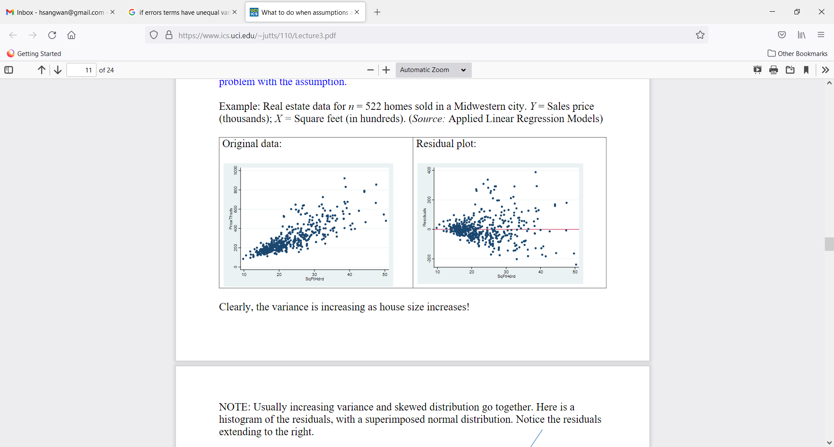
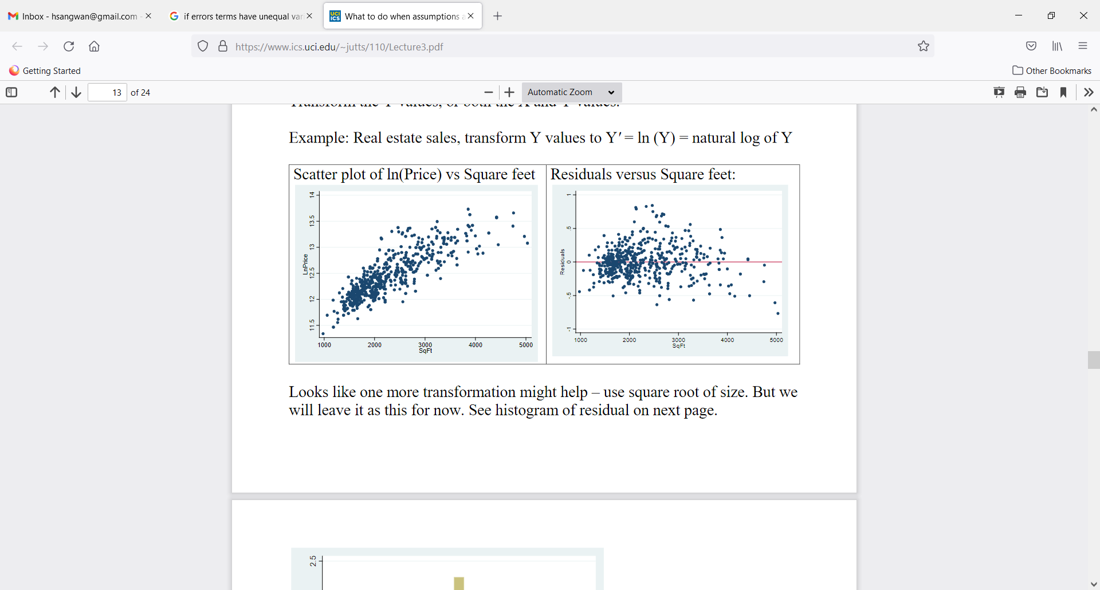
Assumption violated – Error terms have equal variance
Transform Y, i.e., Y’=f(Y) to make variance equal (or try to make it as equal as possible)

Slide 30
Does linear regression imply causation?
Linear Regression deals with dependence of 1 variable (cost per discharge) on other variables (hospital size, # beds, etc.). It does not imply causation
There is NO statistical/analytical reason to assume # beds does not depend on cost per discharge
In other words, in “regression world”, we could equally show dependence of # beds on cost per discharge
The reason we treat cost per discharge as a dependent variable (DV) is due to non-statistical reasons (common sense, theory)
“A strong statistical / analytical relationship can never establish causation: our ideas of causation must come from outside statistics, ultimately from theory or other”
Kendall and Stuart: The Advanced Theory of Statistics

Slide 31
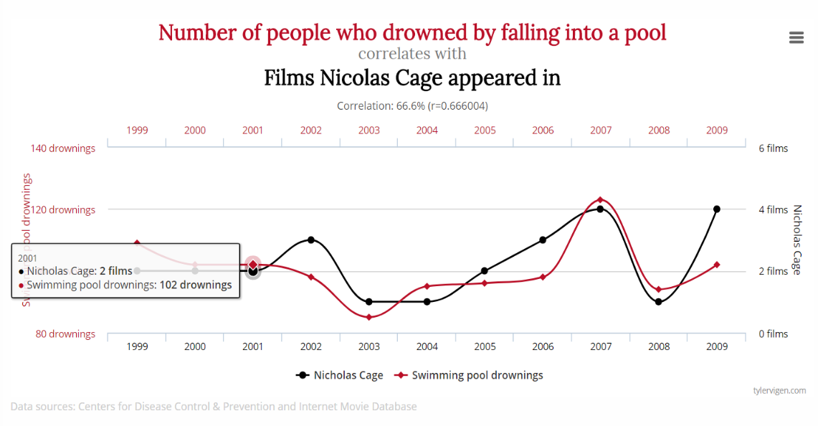
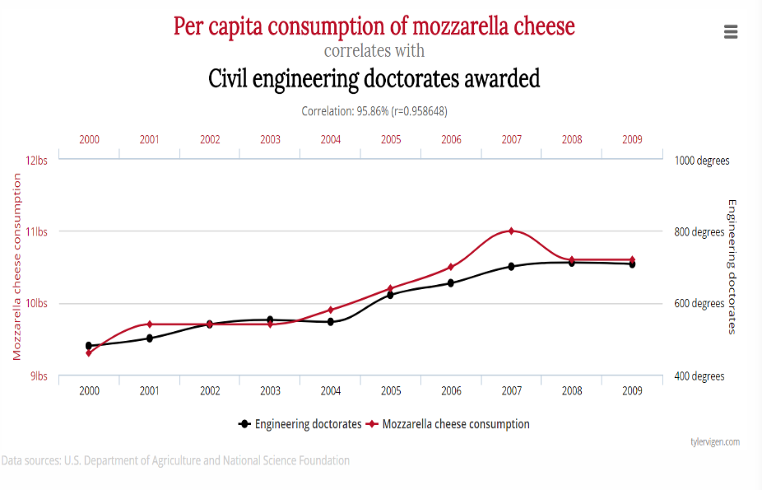
Does linear regression imply causation? (Should LR be used when variables are strongly correlated?)

Slide 32
Does linear regression imply causation?
Customer Satisfaction (CS)
Sales
Cheese consumption
Engineering graduates
X1
X2
LR Algorithm
LR Algorithm
LR Algorithm
Predicted values of sales on the basis of CS
Predicted values of engineering graduates on the basis of cheese consumption
Predicted values of X2 on the basis of X1
Does it make sense: Yes
Does it make sense: No
Does it make sense: maybe / not sure
The algorithm does not know what makes sense and what does not
The algorithm can only tell if the relationship between two variables is strong or weak

Slide 33
Linear Regression vs Correlation
Correlation
Strength of relationship between two or more variables
Symmetric relationships between variables, correlation of (x1, x2) = correlation (x2, x1)
Regression
Asymmetric relationship: dependent variable is random (stochastic), independent variable is given (no stochastic)
Linear Regression (x1, x2) ≠ Linear Regression (x2, x1)

Slide 34

Regression vs Causation vs Correlation

Slide 35
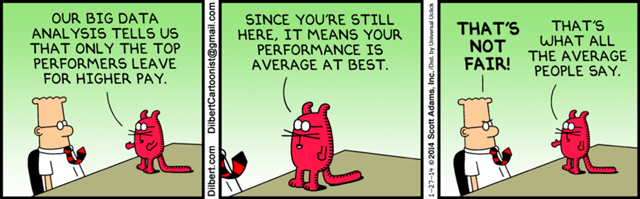
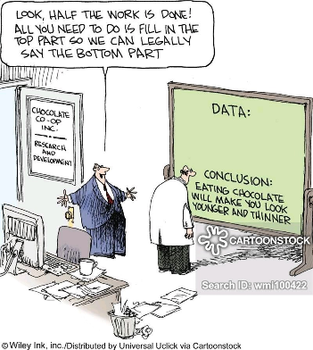
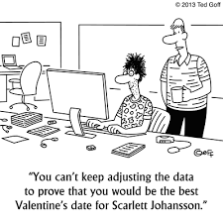
Linear Regression Predictive Analytics – Fun Facts

Slide 36
Linear Regression – Activity

Slide 37
Activity – Linear Regression
Suppose you have data on n=800 individuals on wages, education, experience and gender. In addition, you have information on individual’s marijuana use (coded as 0= No to marijuana use, 1= Yes to marijuana use)
How would you write a regression equation which allow you to estimate effect of marijuana on wages?
Y= a + b M (where M=0 no marijuana; M=1 Marijuana)
Coefficient b estimates the impact of marihuana on wage
How do you test if marijuana usage has different effects on wages for men vs women?
Y= a + b M + c G (where M=0 no marijuana; M=1 Marijuana; G=0 Male, G=1 female)
If (M=0, G=0) → Y= a (or average wages for males who do not consume marihuana)
If (M=0, G=1) → Y= a + c (or average wages for females who do not consume marihuana)
If (M=1, G=0) → Y= a + b (or average wages for males who consume marihuana)
If (M=1, G=1) → Y= a + b + c (or average wages for females who consume marihuana)

Slide 38
Activity – Linear Regression
Suppose you are an investment analyst at a boutique firm in downtown Toronto. One of your clients loves investing in gold and thinks gold provides the best hedging against inflation (compared to TSX). The client reached out to you for advice and provided you with the following data
Is your client’s belief correct, i.e., gold being the best hedge against inflation?
If the client belief is correct → gold prices rise faster with inflation than TSX, i.e., estimated coefficient would be b > d
If the client belief is not correct → gold prices rise slower with inflation than TSX, i.e., estimated coefficient b < d
GP = a + b CPI
TSX = c + d CPI

Slide 39
Activity – Linear Regression
Year | Gold Price (Index) | TSE (Index) | Consumer Price Index (Inflation)
2003 | 148.0 | 53.7 | 60.6
2004 | 193.4 | 53.7 | 65.2
2005 | 307.6 | 58.3 | 72.6
2006 | 612.5 | 68.1 | 82.4
2007 | 459.6 | 74.0 | 90.9
2008 | 376.0 | 68.9 | 96.5
2009 | 423.8 | 92.6 | 99.6
2010 | 360.3 | 92.5 | 103.9
2011 | 317.3 | 108.9 | 107.6
2012 | 376.9 | 136.0 | 109.6
2013 | 446.5 | 161.7 | 113.6
2014 | 436.9 | 149.9 | 118.3
2015 | 381.3 | 180.0 | 124.0
2016 | 384.1 | 183.5 | 130.7
2017 | 362.0 | 206.3 | 136.2

Slide 40
Linear Regression – Housing Data
Each record in the database describes a Boston suburb or town. The data was drawn from the Boston Standard Metropolitan Statistical Area (SMSA) in 1970. The attributes are defined as follows (taken from the UCI Machine Learning Repository):
Key quesiton: How can we predict the MEDV (Median value of owner-occupied homes in $1000s) using all or some of the thirteen predictors or IVs? (Data: HousingData.txt and the code file)
CRIM per capita crime rate by town
ZN proportion of residential land zoned for lots over 25,000 sq.ft.
INDUS proportion of non-retail business acres per town
CHAS Charles River dummy variable (= 1 if tract bounds river; 0 o/w)
NOX nitric oxides concentration (parts per 10 million)
RM average number of rooms per dwelling
AGE proportion of owner-occupied units built prior to 1940
DIS weighted distances to five Boston employment centres
RAD index of accessibility to radial highways
TAX full-value property-tax rate per $10,000
PTRATIO pupil-teacher ratio by town
B 1000(Bk -0.63)^2 where Bk is the proportion of blacks by town
LSTAT % lower status of the population
MEDV Median value of owner-occupied homes in $1000's

Slide 41
Linear Regression – Key Takeaways
Regression analysis is statistical dependence of 1 variable (DV) on other variables (IVs)
Statistical dependence ≠ Dependence in reality
Estimate / predict mean value (not the actual value) of DV on the basis of known / fixed value of IVs

Slide 42
Recommended Readings
Linear Regression with Examples. Spark by Examples. Retrieved from https://sparkbyexamples.com/machine-learning/linear-regression-with-examples/
Naïve Bayes. Retrieved from https://scikit-learn.org/stable/modules/naive_bayes.html
Naïve Bayes classifier. Retrieved from https://www.geeksforgeeks.org/naive-bayes-classifiers/
Top 10 Deep Learning Algorithms You Should Know in 2023. Retrieved from https://www.simplilearn.com/tutorials/deep-learning-tutorial/deep-learning-algorithm

Slide 43
Supervised ML – Classification

Slide 44
Supervised Machine learning – Classification Models
Perceptron
Naïve Bayes
Generative vs discriminatory models

Slide 45
Classification model – Perceptron

Slide 46
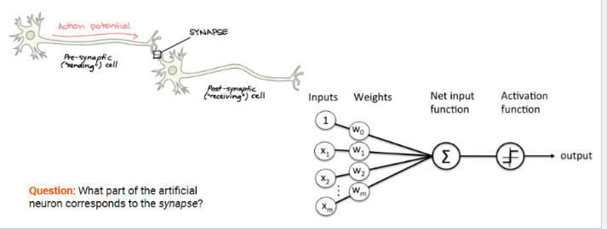
Classification Models – Percpetron
Perceptron – the first classifier
Introduced by Frank Rosenblatt in 1958 (psychologist)
Biological inspiration: synapses store memory
Donald Hebb (1949)
Knowledge and learning occurs in the brain primarily through the formation and change of synapses between neurons
Eric Kandel, Nobel prize 2000
Demonstrated the physiological basis of neural memory storage. i.e. that memories are stored in the strength of the synaptic connections

Slide 47
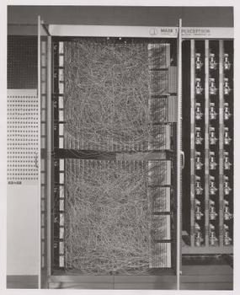
Percpetron – Example
The Mark I Perceptron: A machine designed for image recognition
Inputs: a 20 x 20 array of cadmium sulfide photocells
Weights: potentiometers controlled by motors for weight updates
"the embryo of an electronic computer that [the Navy] expects will be able to walk, talk, see, write, reproduce itself & be conscious of its existence” Rosenblatt about the Perceptron in 1958 (according to New York Times)
This contributed to a hype and subsequent AI winter
Source: Image credit: The Mark I Perceptron, by source (WP:NFCC#4), fair use, https://en.wikipedia.org/w/index.php?curid=47541432

Slide 48
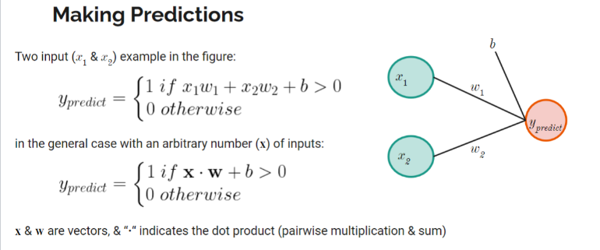
Percpetron – Example
Question: What is y predict if x1 = 0.5, w1 = 2, x2 = 2, w2 = 0.5 and b = -1?

Slide 49
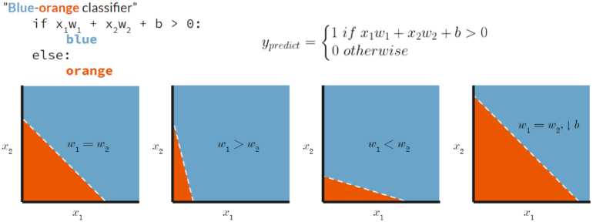
Percpetron – Example
Question: How is the colour blue/orange coded?

Slide 50
Learning in perceptorn
w1 (t+1) = w1 (t) + ɑ (y – y predict) x1; a= learning rate
If error is positive (y > y predict), then increase the weight → next time y predict will be bigger
If error is negative (y < y predict), then decrease the weight → next time y predict will be smaller

Slide 51
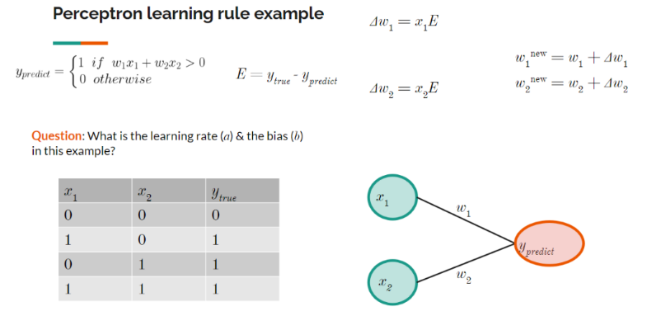
Example – Learning in perceptorn

Slide 52
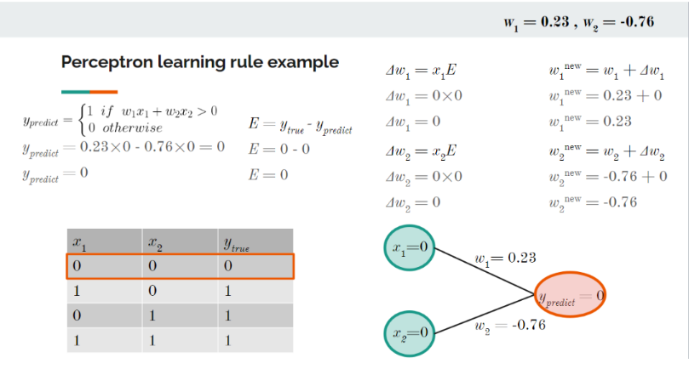
Example – Learning in perceptorn

Slide 53
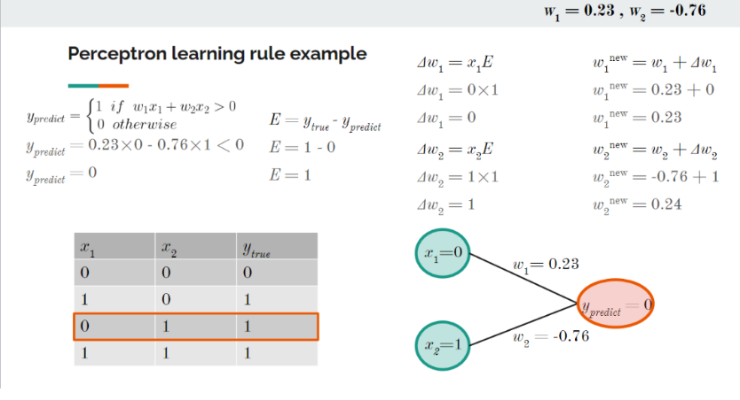
Example – Learning in perceptorn

Slide 54
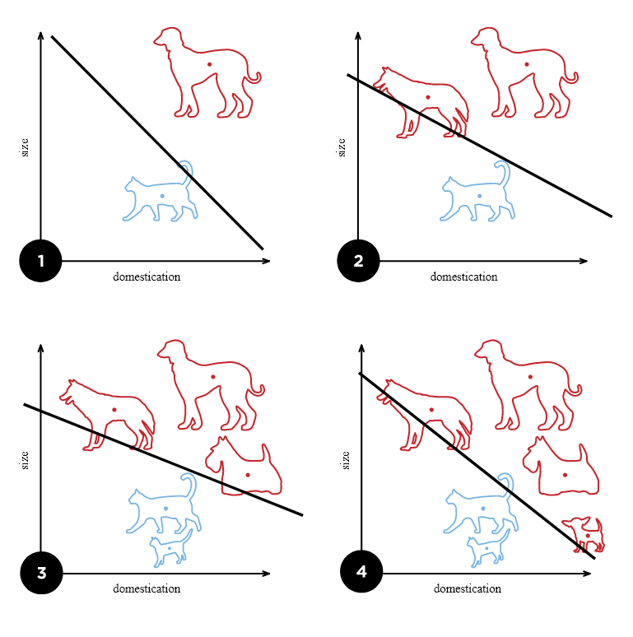
Perceptorn – Applications
Linear classifier: Logistic regression or a linear SVM
Can separate inputs/objects with a linear decision boundary (i.e. a straight line or a flat hyperplane)
Source: Image credit: Cats & dogs by Elizabeth Goodspeed - CC BY-SA 4.0, https://commons.wikimedia.org/w/index.php?curid=40188333

Slide 55
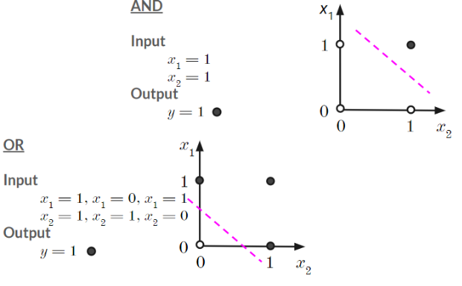
Perceptorn – Limitations
Perceptron is a Linear classifier – it cannot do nonlinear classification
Example: xor (exclusive or) classification
Input: (x1=1, x2=1); output y=1, else y=0
Input: ~ (x1=0, x2=0); output y=1, else y=0

Slide 56
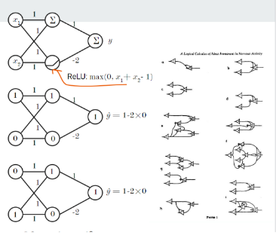
Perceptorn – Limitations
Mcculloch and Pitts (1943) showed that, for example, XOR classification could be achieved with multiple layers But, how to learn the weights in multi-layer networks?
The Perceptron learning-rule doesn’t work in multi-layer networks
Question: What are the outputs when inputs are x1 = 0, x2 = 0 & x1 = 1, x2 = 1?

Slide 57
Classification model – Naïve Bayes classifier

Slide 58
Naïve Bayes classifier
Naive Bayes Classifier: Given the probabilities of each class, how do we make a prediction?
Applied to text classification 1964 by Mosteller and Wallace (statisticians)
The Naive Bayes Classifier is a probabilistic classifier. i.e. it returns the probability of a class instead of the predicted class label (as the Perceptron does)
It estimates the conditional probability of a class given the data, i.e. p(class|data), or p(y|x)
Example: Given an email containing “$$$”, what is the probability that it is a spam?

Slide 59
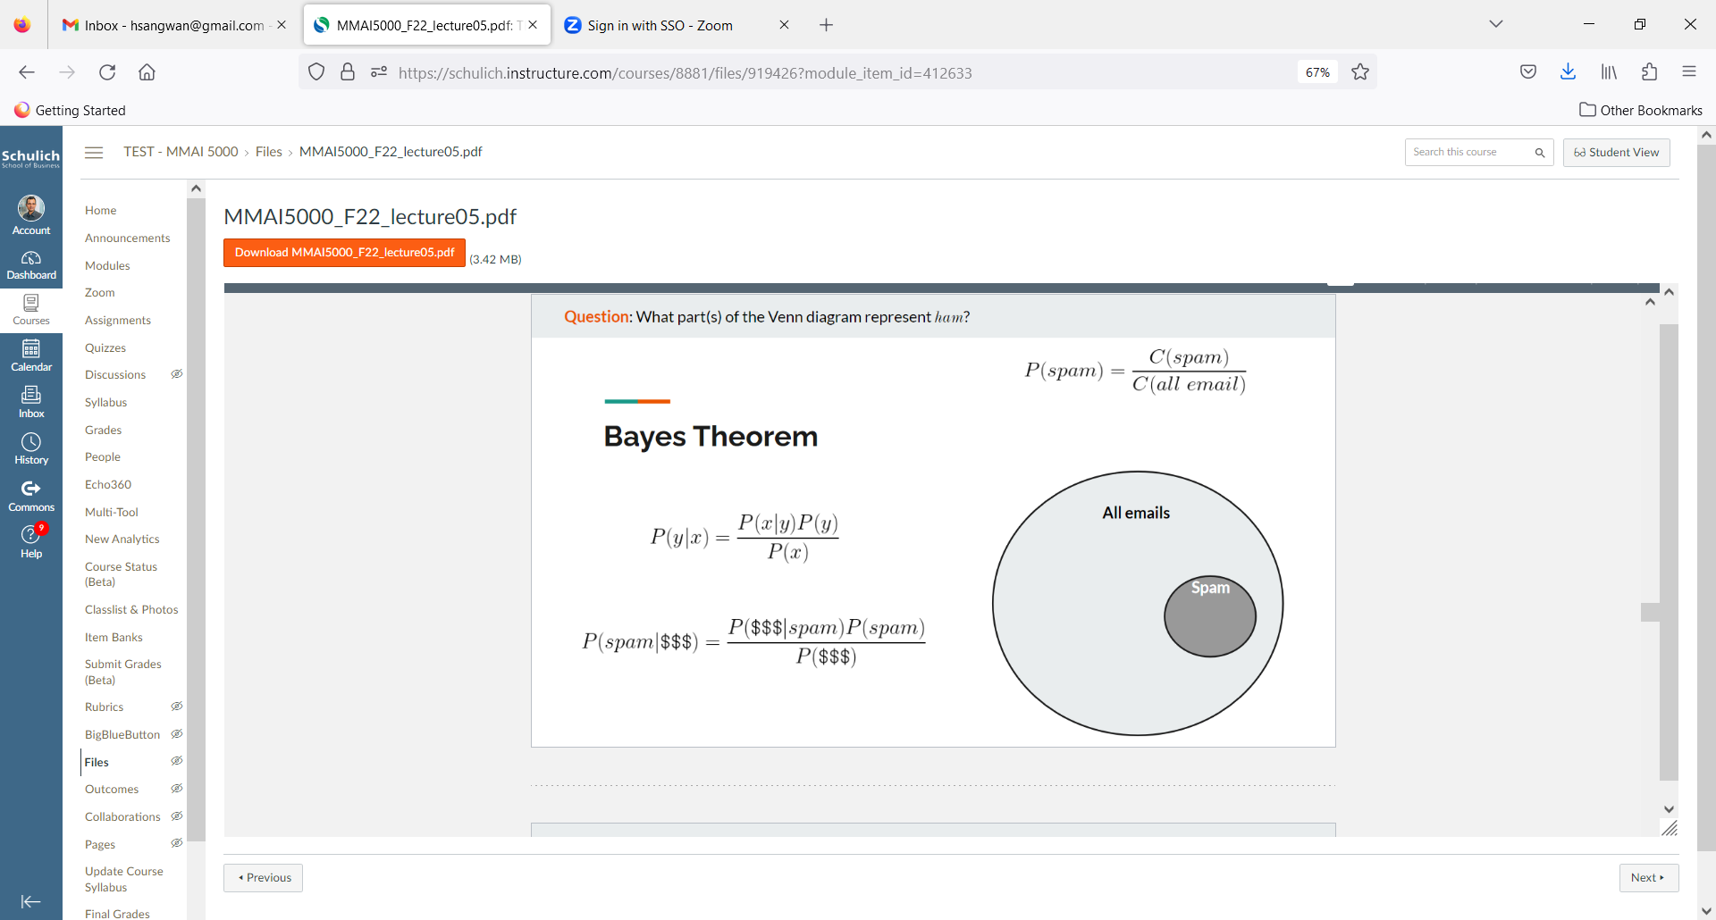
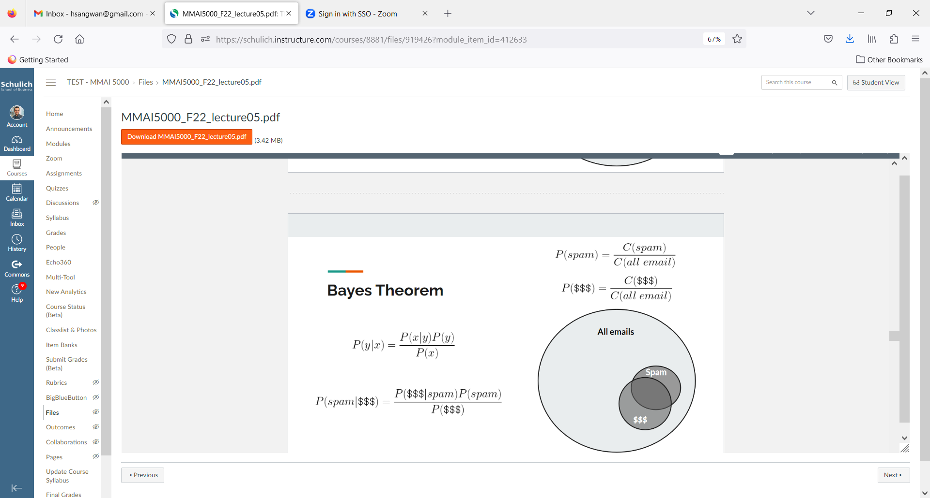
Naïve Bayes classifier
There is an email containing “$$$”, what is the probability it is a spam?
Bayes Theorem (15 minutes): https://youtu.be/HZGCoVF3YvM

Slide 60
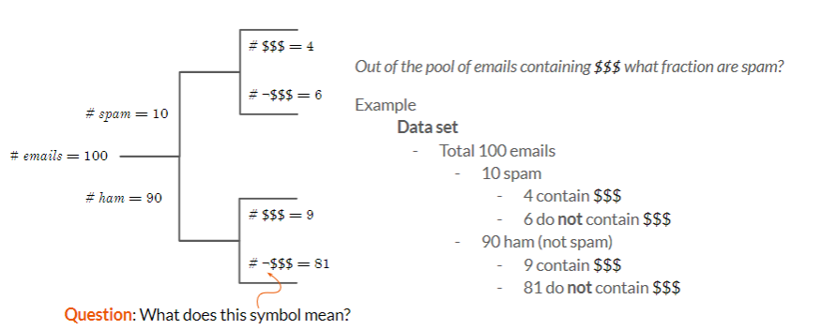
Naïve Bayes classifier
There is an email containing “$$$”, what is the probability it is a spam?
In what sense does a Naïve Bayes Classifier learn? What was learning in the example?

Slide 61
Multinomial Naïve Bayes classifier – classifier with multiple features
Multinomial Naïve Bayes Classifier: (“$$$”, “lottery”, …)
Multinomial Naive Bayes Classifier = P(f1, f2, ..., fn | c) = P(f1 | c)P(f2 | c) ... P(fn | c)
Assuming features are independent
Question: Is the Multinomial Naïve Bayes Classifier a linear classifier?

Slide 62
Machine Learning Basics – Generative vs Discriminatory Models

Slide 63
Generative models (vs discriminatory models)
Model the joint probability distribution: P(x1, x2, , ..., xn), P(x, y) or P(x, c)
Classification: generative vs discriminative, an intuitive example
Task: figure out what language someone is speaking
Generative approach: learn each language and determine which language best fits what is heard
Discriminative approach: Determine the linguistic differences between languages

Slide 64
Generative models (vs discriminatory models)
Model the joint probability distribution: P(x1, x2, , ..., xn), P(x, y) or P(x, c)
Classification: generative vs discriminative, an intuitive example
Task: figure out what language someone is speaking
Generative approach: learn each language and determine which language best fits what is heard
Discriminative approach: Determine the linguistic differences between languages

Slide 65
Classification – Generative (vs discriminatory models)
Classification: Given some input data x, what is the most probable class y? I.e. arg max P(y | x)
Generative approach
Learns the joint probability distribution, P(x, y) [also P(x & y) & P(x ∩ y)]
Classification is done by using Bayes Theorem to get P(y | x) from P(x, y) & P(y)
Can also be used to generate likely data (i.e. x, y pairs)
Examples:
Naïve Bayes, Hidden Markov Models, (HMM), Sigmoidal Belief Networks, Gaussian Mixture Models, N-gram LM, Neural LM, Generative Adversarial, Network (GAN; generative and discriminative), Variational Auto encoder (VAE)
Discriminative approach
Directly learns the conditional probability distribution P(y|x)
Examples:
Logistic/linear regression, SVM, traditional, neural networks, Decision Trees, Random Forests, XGBoost

Slide 66
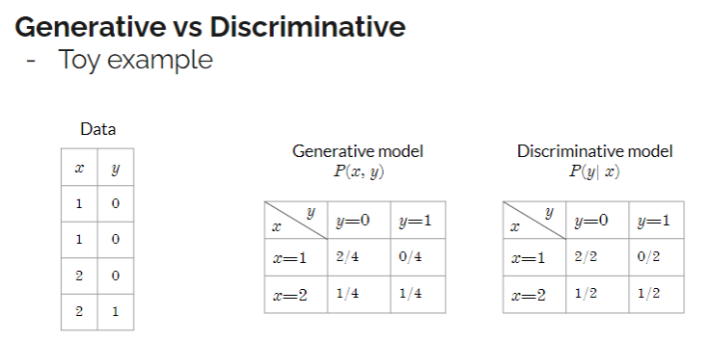
Classification – Generative (vs discriminatory models)
Example

Slide 67
Activity – Generative vs Discriminatory models

Slide 68
Recommended Readings
Linear Regression with Examples. Spark by Examples. Retrieved from https://sparkbyexamples.com/machine-learning/linear-regression-with-examples/
Naïve Bayes. Retrieved from https://scikit-learn.org/stable/modules/naive_bayes.html
Naïve Bayes classifier. Retrieved from https://www.geeksforgeeks.org/naive-bayes-classifiers/
Top 10 Deep Learning Algorithms You Should Know in 2023. Retrieved from https://www.simplilearn.com/tutorials/deep-learning-tutorial/deep-learning-algorithm

